Slide 1
Introduction to Vectors
MCV4U

Slide 2
Key Terms
scalar
vector
displacement
velocity
force
geometric vector
magnitude
true bearing
quadrant bearing
parallel vectors
equivalent vectors
opposite vectors

Slide 3
Vectors and Scalars
A scalar is a quantity that describes magnitude or size only. It does not include direction.
A vector is a quantity that has a magnitude and a direction.
Force is a vector quantity that describes an influence that can cause an object of a given mass to move in a certain direction.
Displacement is a vector quantity that describes the position of an object.
Velocity is a quantity that has both magnitude and direction.

Slide 4
Vectors and Scalars
A geometric vector is an arrow diagram or directed line segment that shows both magnitude and direction.
The magnitude of a vector is the length of the directed line segment. It is designated using absolute value brackets, so the magnitude of vector is indicated by | |.

Slide 5
Vector or Scalar?
a distance of 10 m
an acceleration of 8 m/s² due west
a volume of 40 L
a displacement of 25 m to the right
a weight of 50 N
a mass of 5 kg

Slide 6
Representing Vectors
Geometric vectors
B
5 km
A
30 °
------------------------------------------------------

Slide 7
Representing Vectors
In symbols, ending the endpoints of the arrow:
Point A is the initial point, or “tail”
Point B is the terminal point, or “tip”

Slide 8
Representing Vectors
In symbols, using a single letter, such as:

Slide 9
Representing the Direction of a Vector
as an angle, measured counter-clockwise from a horizontal line
30°

Slide 10
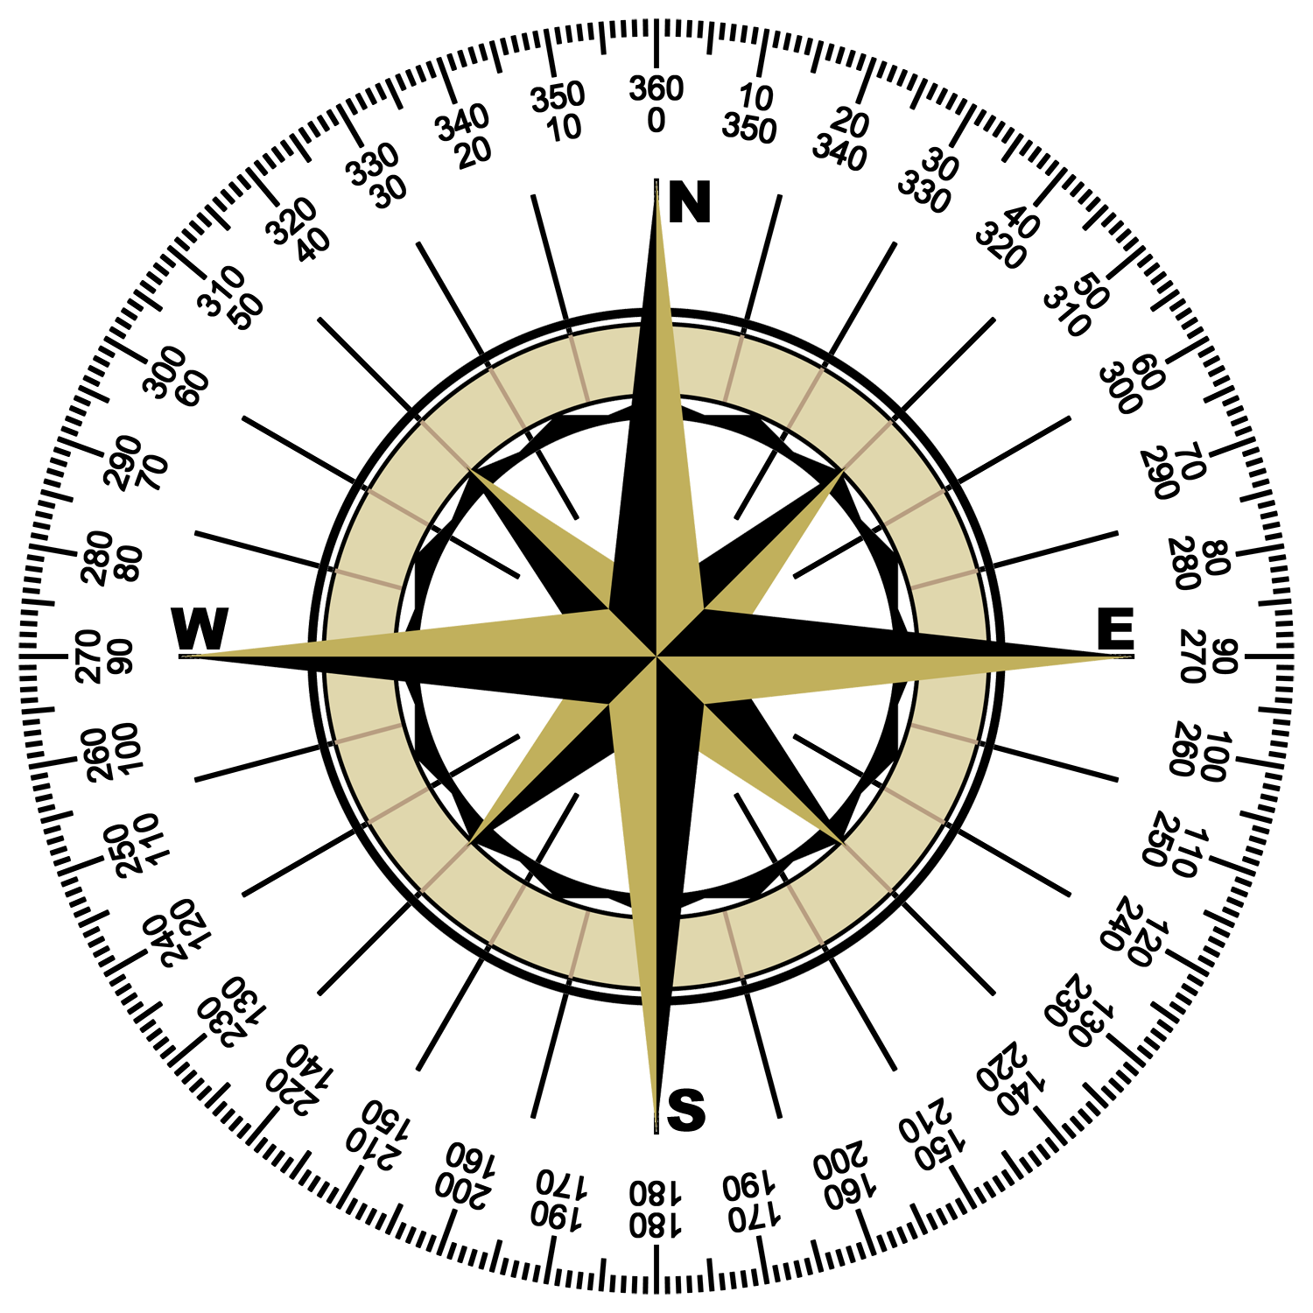
Representing the Direction of a Vector
A true bearing is a compass measurement where the angle is represented as a three-digit number measured clockwise from North
e.g. in the true bearing system,
north is 000°,
west is 270°, and
east is 090°

Slide 11
Representing the Direction of a Vector
A quadrant bearing is expressed as an angle between 0° and 90° east or west of the north-south axis and includes three components:
(i) the direction from which it is measured
(ii) the angle
(iii) the direction towards which it is measured
e.g. Draw a vector with the
quadrant bearing
[N 30° W]
N
30°

Slide 12
VECTOR GROUPS/PAIRS
Parallel vectors have the same or opposite direction, but not necessarily the same magnitude.
Equivalent vectors have the same direction and magnitude.
Opposite vectors have the same magnitude but opposite direction.

Slide 13
Example
Consider the rectangle ABCD where F is the intersection of the diagonals.
a) List all equivalent vectors.
b) List all opposite vectors.

